Slide 1
OSPF – Stub Areas
Stub areas

Slide 2
Resources
OSPF Configuration Guide
http://www.cisco.com/c/en/us/td/docs/ios-xml/ios/iproute_ospf/configuration/15-mt/iro-15-mt-book.html
OSPF Design Guide
http://www.cisco.com/c/en/us/support/docs/ip/open-shortest-path-first-ospf/7039-1.html
RFC 2328
https://www.ietf.org/rfc/rfc2328.txt

Slide 3
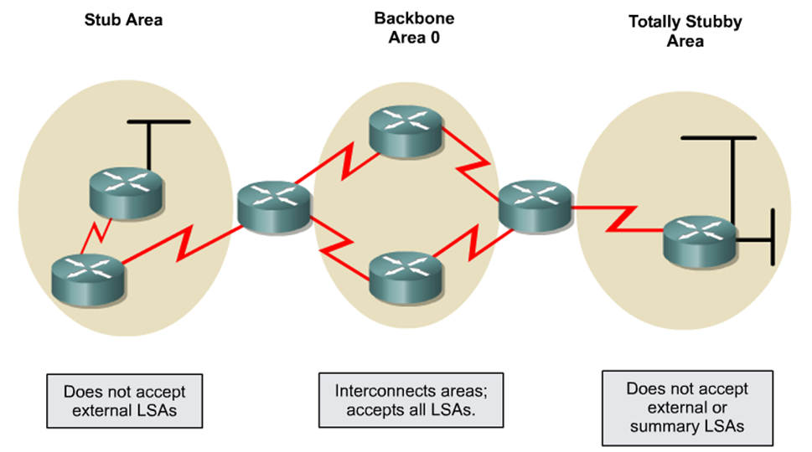
OSPF Special Area Types
The OSPF standard area can be further divided into four types of stub areas:
Stub area
Totally stubby area
NSSA
Totally stubby NSSA
Notes:
Stub area
This area type does not accept information about routes external to the autonomous system, such as routes from non-OSPF sources. If routers need to route to networks outside the autonomous system, they use a default route, indicated as 0.0.0.0. Stub areas cannot contain ASBRs (except that the ABRs may also be ASBRs).
Totally stubby area
This Cisco proprietary area type does not accept external autonomous system routes or summary routes from other areas internal to the autonomous system. If a router needs to send a packet to a network external to the area, it sends the packet using a default route. Totally stubby areas cannot contain ASBRs (except that the ABRs may also be ASBRs).
NSSA
NSSA is an addendum to the OSPF RFC. This area type defines a special LSA type 7. NSSA offers benefits that are similar to those of a stub area. They do not accept information about routes external to the autonomous system, but instead use a default route for external networks. However, NSSAs allow ASBRs, which is against the rules in a stub area.
Totally stubby NSSA
Cisco routers also allow an area to be configured as a totally stubby NSSA, which allows ASBRs, but does not accept external routes or summary routes from other areas. A default route is used to get to networks outside of the area.

Slide 4
OSPF Area Types
Area Type | Accepts routes within area (O) | Accepts routes from other areas (O IA) | Accepts external routes (O E1 and O E2) | Allows ASBR | Cisco proprietary
Standard | Yes | Yes | Yes | Yes | No
Backbone | Yes | Yes | Yes | Yes | No
Stub | Yes | Yes | No (uses default route) | No | No
Totally stubby | Yes | No (uses default route) | No (uses default route) | No | Yes
NSSA | Yes | Yes | No (uses default route) | Yes | No
Totally stubby NSSA | Yes | No (uses default route) | No (uses default route) | Yes | Yes

Slide 5
Stub and Totally Stub Area Characteristics
An area qualifies as stub or totally stubby area if it has the following characteristics:
The area is not the backbone area (area 0).
There is a single exit point from that area.
If there are multiple exits, one or more ABRs should inject a default route into the stub area however suboptimal routing paths might occur.
There is no ASBR inside the area.
The area is not used as a transit area for virtual links.

Slide 6
Stub Area
Typically used in a hub-and-spoke network.
Area does not accept external summary routes from non-OSPF sources (e.g., RIP, EIGRP).
Specifically, it does not accept Types 4 and 5 LSAs.
A default route (0.0.0.0) is propagated throughout the area to send a packet to an external network.
Notes:
Can significantly reduce LSDB size

Slide 7
Configuring a Stub Area
OSPF Area 0
Stub Area 2
192.168.14.0 /24
ABR
192.168.15.0 /30
External AS
.1
.1
.2
Fa0/0
R3
S0/0/0
S0/0/0
R4
R3(config)# interface FastEthernet0/0
R3(config-if)# ip address 192.168.14.1 255.255.255.0
R3(config-if)# interface Serial 0/0/0
R3(config-if)# ip address 192.168.15.1 255.255.255.252
R3(config-if)# router ospf 100
R3(config-router)# network 192.168.14.0.0 0.0.0.255 area 0
R3(config-router)# network 192.168.15.0.0 0.0.0.255 area 2
R3(config-router)# area 2 stub
R3(config-router)#
R4(config-if)# interface Serial 0/0/0
R4(config-if)# ip address 192.168.15.2 255.255.255.252
R4(config-if)# router ospf 100
R4(config-router)# network 192.168.15.0.0 0.0.0.255 area 2
R4(config-router)# area 2 stub
R4(config-router)#
Notes:
The last line in each router configuration (area 2 stub) defines the stub area. The R3 router (the ABR) automatically advertises 0.0.0.0 (the default route) with a default cost metric of 1 into the stub area.
Each router in the stub area must be configured with the area stub command.

Slide 8
Totally Stubby Area
Cisco proprietary solution that is better than stub area.
Area does not accept external AS routes or inter-area routes.
Specifically, it does not accept Types 3, 4 and 5 LSAs.
It recognizes only intra-area routes and the default route 0.0.0.0.
A default route (0.0.0.0) is propagated throughout the area.
Notes:
The default route =

Slide 9
Configuring a Totally Stubby Area
OSPF Area 0
Totally Stubby Area 2
192.168.14.0 /24
ABR
192.168.15.0 /30
External AS
.1
.1
.2
Fa0/0
R3
S0/0/0
S0/0/0
R4
R3(config)# interface FastEthernet0/0
R3(config-if)# ip address 192.168.14.1 255.255.255.0
R3(config-if)# interface Serial 0/0/0
R3(config-if)# ip address 192.168.15.1 255.255.255.252
R3(config-if)# router ospf 100
R3(config-router)# network 192.168.14.0.0 0.0.0.255 area 0
R3(config-router)# network 192.168.15.0.0 0.0.0.255 area 2
R3(config-router)# area 2 stub no-summary
R3(config-router)#
R4(config-if)# interface Serial 0/0/0
R4(config-if)# ip address 192.168.15.2 255.255.255.252
R4(config-if)# router ospf 100
R4(config-router)# network 192.168.15.0.0 0.0.0.255 area 2
R4(config-router)# area 2 stub
R4(config-router)#
Notes:
Notice that R4 still requires the area 1 stub command, yet the no-summary keyword is not required.
Only ABRs (R3) use the no-summary keyword to keep summary LSAs from being propagated into another area.

Slide 10
Not-So-Stubby Area (NSSA)
Similar to a Stub Area, except that it is primarily used to connect to ISPs, or when redistribution is required.
Specifically, it does not accept Types 4 and 5 LSAs.
Allows the importing of external routes as Type 7 LSAs and converts them to Type 5 LSAs on the ABR.
Better than creating stub areas and also useful for spokes.
NSSA Area 1
Area 0
ABR
192.168.15.0 /30
RIP AS
172.16.20.0 /24
R1
R2
R3
RIP
Type 7 LSA : 172.16.20.0/24
Type 5 LSA : 172.16.0.0/16
Notes:
The NSSA feature allows an area to retain the other stub area features—the ABR sends a default route into the NSSA instead of external routes from other ASBRs—while also allowing an ASBR to be inside of the area. Recall that one of the rules of stub areas is that there must not be an ASBR inside of a stub area.
An NSSA—a not-so-stubby area— bends this rule.

Slide 11
Configuring a NSSA Area
NSSA Area 1
Area 0
172.17.20.0 /24
ABR
172.17.0.0
RIP AS
172.16.10.0
172.16.11.0
.1
.2
R1
Fa0/0
Fa0/0
R2
0.0.0.0 Default Route
R1(config)# router ospf 10
R1(config-router)# redistribute rip subnets
R1(config-router)# default metric 150
R1(config-router)# network 172.17.0.0 0.0.255.255 area 1
R1(config-router)# area 1 nssa
R1(config-router)#
R2(config)# router ospf 10
R2(config-router)# summary-address 172.16.0.0 255.255.0.0
R2(config-router)# network 172.17.20.0 0.0.0.255 area 1
R2(config-router)# network 172.17.0.0 0.0.255.255 area 0
R2(config-router)# area 1 nssa default-information-originate
R2(config-router)#
Notes:
R1 is the ASBR that redistributes RIP routes into area 1, the NSSA.
R2 is the NSSA ABR; this router converts type 7 LSAs into type 5 LSAs for advertisement into backbone area 0.
R2 is also configured to summarize the type 5 LSAs that originate from the RIP network; the 172.16.0.0 subnets are summarized to 172.16.0.0/16 and are advertised into area 0.
To cause R2 (the NSSA ABR) to generate an O*N2 default route (O*N2 0.0.0.0/0) into the NSSA, the default-information-originate parameter is used on the area area-id nssa command on R2.
The default-metric command is used in conjunction with the redistribute router configuration command to cause the current routing protocol to use the same metric value for all redistributed routes. A default metric helps solve the problem of redistributing routes with incompatible metrics.

Slide 12
Totally Stubby NSSA
Cisco proprietary solution to NSSA.
Area does not accept external AS routes or inter-area routes.
Specifically, it does not accept Types 3, 4 and 5 LSAs.
It recognizes only intra-area routes and the default route 0.0.0.0.
A default route (0.0.0.0) is propagated throughout the area.
The ABR of a totally stubby NSSA must be configured with the no-summary keyword to prevent the flooding of summary routes for other areas into the NSSA area.
Notes:
The NSSA feature allows an area to retain the other stub area features—the ABR sends a default route into the NSSA instead of external routes from other ASBRs—while also allowing an ASBR to be inside of the area. Recall that one of the rules of stub areas is that there must not be an ASBR inside of a stub area.
An NSSA—a not-so-stubby area— bends this rule.

Slide 13
Configuring a Totally Stubby NSSA Area
NSSA Area 1
Area 0
172.17.20.0 /24
ABR
172.17.0.0
RIP AS
172.16.10.0
172.16.11.0
.1
.2
R1
Fa0/0
Fa0/0
R2
0.0.0.0 Default Route
R1(config)# router ospf 10
R1(config-router)# redistribute rip subnets
R1(config-router)# default metric 150
R1(config-router)# network 172.17.0.0 0.0.255.255 area 1
R1(config-router)# area 1 nssa
R1(config-router)#
R2(config)# router ospf 10
R2(config-router)# summary-address 172.16.0.0 255.255.0.0
R2(config-router)# network 172.17.20.0 0.0.0.255 area 1
R2(config-router)# network 172.17.0.0 0.0.255.255 area 0
R2(config-router)# area 1 nssa no-summary
R2(config-router)#
Notes:
Notice that the ABR is using the area 1 nssa no-summary command.
This command works exactly the same as the totally stubby technique.
A single default route replaces both inbound external (type 5) LSAs and summary (type 3 and 4) LSAs into the area.
The NSSA ABR, Router R2, automatically generates the O*N2 default route into the NSSA area when the no-summary option is configured at the ABR, so the default-information-originate parameter is not required.

Slide 14
How Does OSPF Generate Default Routes?
Depends on the type of area.
In a standard area:
Routers do not automatically generate default routes.
The default-information originate command must be used.
In a stub and totally stubby area:
The ABR automatically generates a summary LSA with the link-state ID 0.0.0.0.
The default-information originate command is not required.
This is true even if the ABR does not have a default route.
In an NSSA area:
The ABR generates the default route, but not by default.
To force the ABR to generate the default route, use the area area-id nssa default-information-originate command.
In a totally stubby NSSA:
The ABR automatically generates a default route.

Slide 15
Sourcing Routes
network statement
Internal
O or OIA
Redistribution
External
E1 or E2

Slide 16
ASBR – Type 1 and 2 Routes
The cost of an external route varies, depending on the external type configured on the ASBR.
An ASBR can be configured to send out two types of external routes into OSPF.
Denoted in the routing table as E1 for Type 1
Denoted in the routing table as E2 for Type 2.
Depending on the type, OSPF calculates the cost of external routes differently.

Slide 17
ASBR – Type 1 and 2 Routes
O E1 Routes
The metric is calculated by adding the external cost to the internal cost of each link that the packet crosses.
Use this packet type when there are multiple ASBRs advertising a route to the same autonomous system.
O E2 Routes
The packet will always have the external cost assigned, no matter where in the area it crosses.
Default setting on ASBRs.
Use this packet type if only one router is advertising a route to the autonomous system.
Type 2 routes are preferred over Type 1 routes unless two equal cost routes exist to the destination.

Slide 18

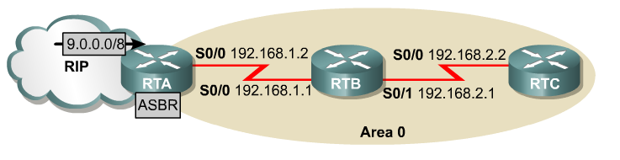
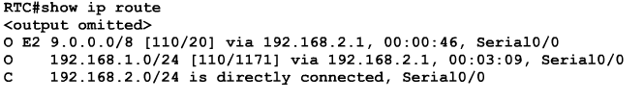
E2 Routes
By default, RTA uses a Type 2 metrics to send external routing information.
RTB will receive the external RIP routes, including 9.0.0.0/8 from RTA.
When RTB forwards this route, the metric for the external route remains the same (in this case, 20).

Slide 19
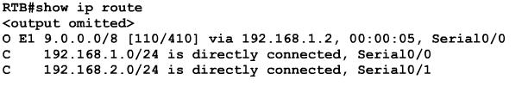

E1 Routes
If RTA is configured to use a Type 1 metric with external routes, OSPF will increment the metric value of the external route according to its standard cost algorithm.

